Slide 1
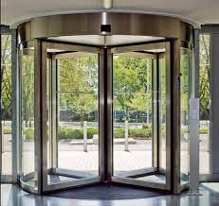
The Revolving Door
Moving Libraries to an Accessible Digital Environment
Kathryn Weber-Hottleman
IT Accessibility Coordinator
University of Connecticut

Slide 2
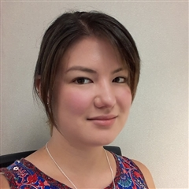
Who am I?
Kathryn@uconn.edu
linkedin.com/in/kathryn-w-510a0137/
https://accessibility.its.uconn.edu/the-revolving-door/

Slide 3
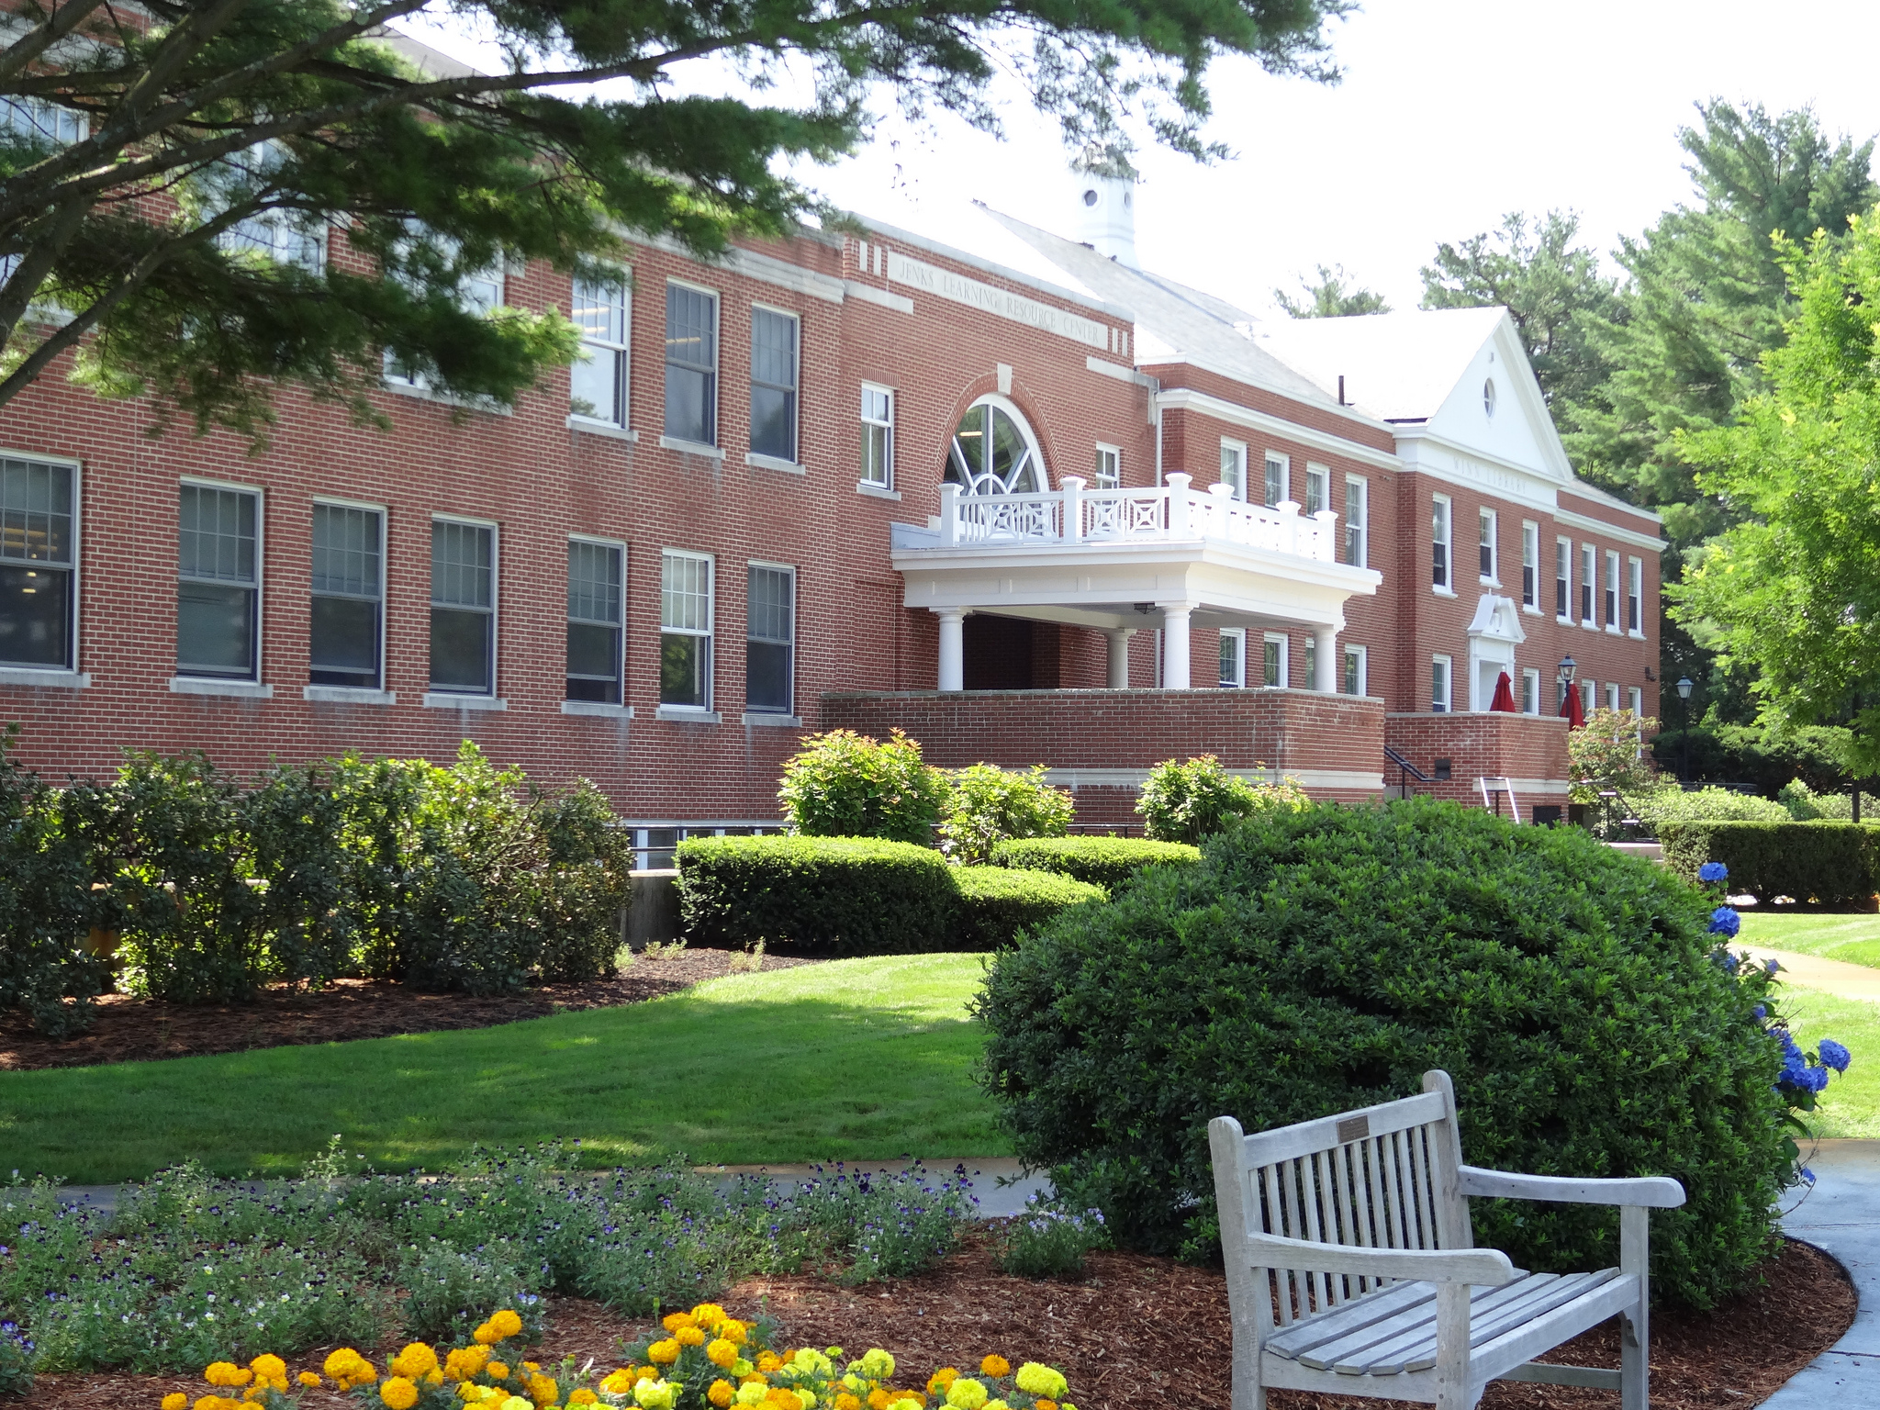
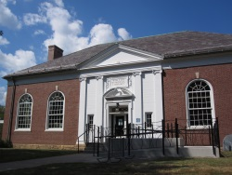
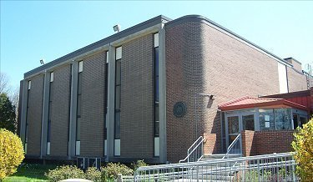
Libraries changed my life!
Notes:
Libraries changed my life
Got a dozen books per visit
CDs and movies in college
Spent hour studying there
Move to a new city, if there for 1 year+ would find my local library

Slide 4

Libraries Serve Everyone
Create a sense of belonging
Promote education
Provide information
Notes:
Libraries serve everyone
Create a sense of belonging: Anyone can go there
Promote education: Books and programming
Provide information: Books, movies, internet connections

Slide 5

Sense of Belonging
Anyone can walk into a library and get service
Notes:
Anyone can walk into a library and get service
Regardless of ability/disability
Because of this, need to be accessible from the get-go
Especially important during COVID, where books and programming are online: no knowing who may attend, or from where they may attend
Physical access gives way to digital access
Websites are the new ramps

Slide 6

Promote Education
Books and programming: Moving digital
Notes:
Advent of digital books
Many different formats: ePub, PDF/scans, etc.
Audio books: started with cassettes and CDs, shifted to downloadable mp3s
Shifting interlibrary loan: Can get full text documents from other libraries, not just books
Think about articles, reviews, etc.
Consideration: how are we making books accessible for people who are blind? Deaf?
Audiobooks
Ebooks
Programming: Shifted online because of COVID
Tools and resources: Live subtitles, translator for Facebook live events
Facebook Live > https://scontent-lga3-2.xx.fbcdn.net/v/t39.8562-6/66086585_1127049914146262_5362522782250827776_n.pdf?_nc_cat=100&ccb=1-3&_nc_sid=ae5e01&_nc_ohc=fIx2YPTZ5lMAX98eRyc&_nc_ht=scontent-lga3-2.xx&oh=8f9fed3afcc7ccf8463739485fb46083&oe=60BF86A4
DOES NOT HAVE LIVE CAPTIONS BUILT IN LIKE ZOOM/TEAMS
Live captions through Zoom, Teams, PowerPoint, Translator as a backup
Zoom > https://support.zoom.us/hc/en-us/articles/207279736-Closed-captioning-and-live-transcription
Teams > https://support.microsoft.com/en-us/office/use-live-captions-in-a-teams-meeting-4be2d304-f675-4b57-8347-cbd000a21260
Microsoft Translator > https://www.microsoft.com/en-us/translator/
Microsoft PowerPoint > https://support.microsoft.com/en-us/office/present-with-real-time-automatic-captions-or-subtitles-in-powerpoint-68d20e49-aec3-456a-939d-34a79e8ddd5f#:~:text=To%20have%20subtitles%20always%20start,words%20will%20appear%20on%2Dscreen.
Clear descriptions of visuals > https://accessibility.its.uconn.edu/images/
Neurodivergent patrons: high contrast, uncluttered slides, no flashing lights, structure
Encouraging people to experience books through media other than print
Tactile and interactive engagement: using examples people can find around their homes
No subtleties: keep it very literal and straightforward > people with ASD, NVLD, do NOT understand subtleties and idioms
Captions could be overwhelming, or they could be helpful: give people option to turn off

Slide 7
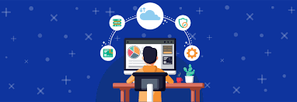
Providing Information
Books
Movies and CDs
Internet connections
Notes:
Books: ePub, audiobooks, PDFs (avoid), full text online (HTML)
Access to search engines, like EBSCO, JSTOR, etc.
Movies: Subtitles vs. captions, foreign language movies
What are subtitles
What are captions
How do we make foreign language movies accessible for people who can’t see subtitles?
Internet connections: Screen readers on machines
NVDA, VoiceOver
How to use instructions

Slide 8
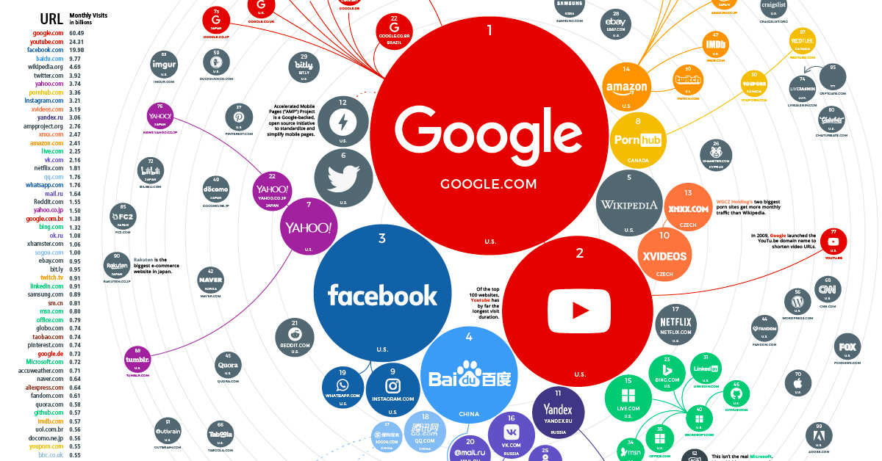
The Hub
Websites: Where people look for information first
Notes:
Website accessibility: Websites are where people will look for information first
Basic accessibility principles/considerations: POUR > https://webaim.org/articles/pour/
Top 5 accessibility strategies
How to translate to books, etc.
How to > https://accessibility.its.uconn.edu/intro-creating-accessible-digital-content/
Alternative text
YouTube videos
Documents/files
Color contrast
Keyboard accessibility: screen reader implications
Hyperlinks
Social media: Facebook, Twitter, Instagram, etc. > https://accessibility.its.uconn.edu/social-media/
How to do this when you have few resources (people, money, etc.)

Slide 9

Takeaways
Commit to 3 things that you can do to make your library more accessible
Notes:
Pick 3 things to commit to doing
Top 3
Plan for enacting
Get creative! There are LOTS of ways to make content accessible: not prescriptive at all!

Slide 10

Q & A
Contact me!
Kathryn@uconn.edu
linkedin.com/in/kathryn-w-510a0137/
https://accessibility.its.uconn.edu/the-revolving-door/

